Slide 1
Please download exercises from:
https://github.com/thushv89/tekbac_deeplearning_course_exercises

Slide 2
Introduction to Jupyter Notebooks
Thushan Ganegedara

Slide 3
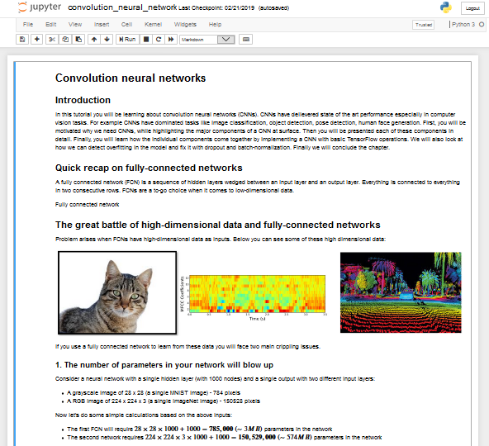
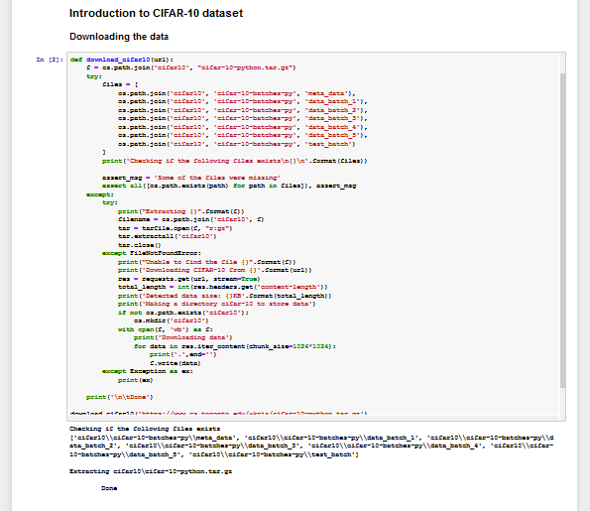
Why Jupyter notebooks?
Jupyter notebooks are amazing!
Ability to tell stories
Quick prototyping
Separating out code to individual cells (e.g. great for exploratory data analysis)

Slide 4
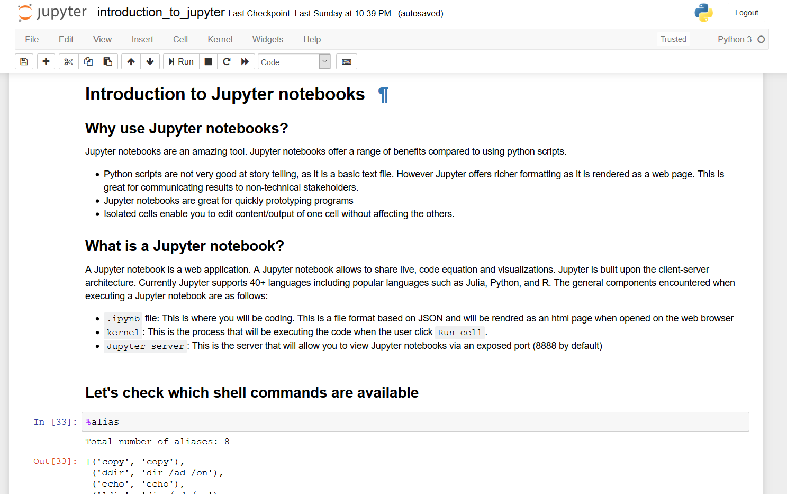
Anatomy of Jupyter
This is the server that will allow you to view Jupyter notebooks
Client (Web browser)
ZeroMQ
Jupyter Server
Port 8888
Jupyter Kernel
This is the process that will be executing the code
{ "cells": [ { "cell_type": "markdown", "metadata": {}, "source": [ "# Introduction to Jupyter notebooks\n", "\n", "## Why use Jupyter notebooks?\n", "\n", "Jupyter notebooks are an amazing tool. …" ] },
{ "cell_type": "markdown", "metadata": {}, "source": [ "## Let's check which shell commands are available" ] }, { "cell_type": "code", "execution_count": 33, "metadata": {}, "outputs": [ { "name": "stdout", "output_type": "stream", "text": [ "Total number of aliases: 8\n" ] },
…
.ipynb
This is where you will be coding. This is a file format based on JSON and will be rendered as html
More info: https://jupyter.readthedocs.io/en/latest/architecture/how_jupyter_ipython_work.html

Slide 5
What we will explore
Magic commands
Executing magic commands
Executing Python code
Markdown in notebooks
Writing equations
Plotting
Accessing past inputs/outputs

Slide 6
Magic commands
Kernel specific commands
Provides some handy commands like “ls” and “mkdir”

Slide 7
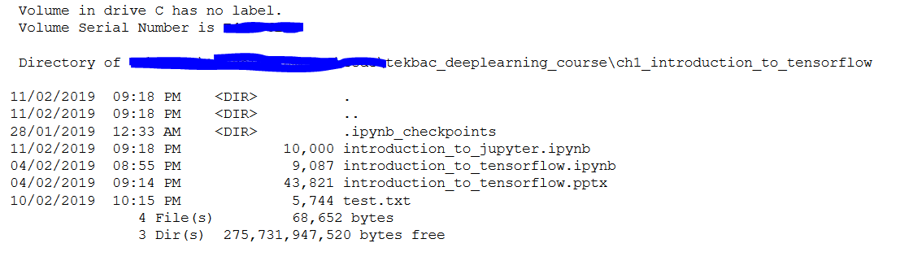
Executing magic
Use %ls to list the current working directory

Slide 8
More on magic
Use %env to list environmental variables
Handy way to know if you made any changes to environmental variables
Python specific magics
'c:\\anaconda3\\envs\\tekbac.deeplearning\\Library\\bin;C:\\Anaconda3\\envs\\tekbac.deeplearning …’
import matplotlib.pyplot as plt
%pdef plt.scatter
%pdoc plt.scatter

Slide 9
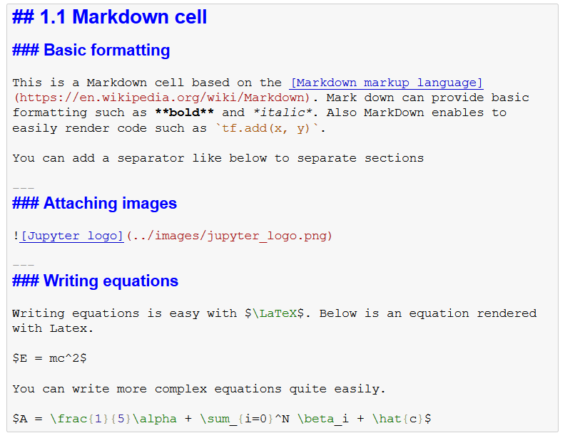
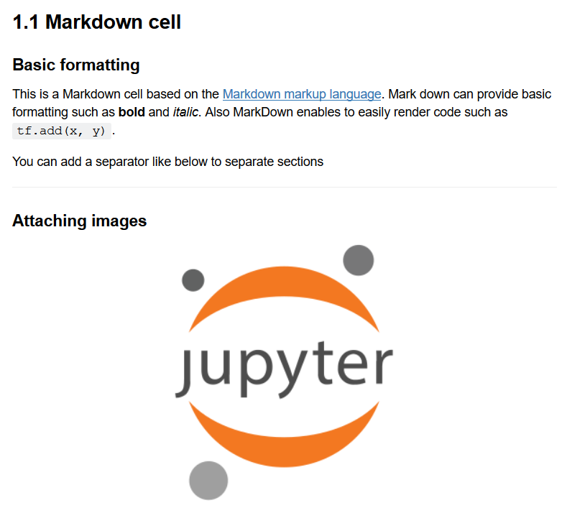
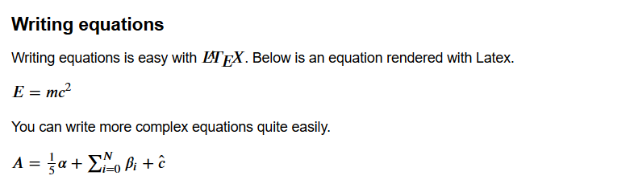
Markdown

Slide 10
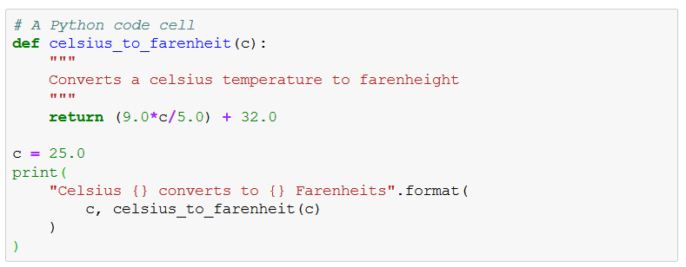
Executing Python code
Create a cell by Insert -> Insert Cell Below
Write the following script
Run the code (Shift + Enter)

Slide 11
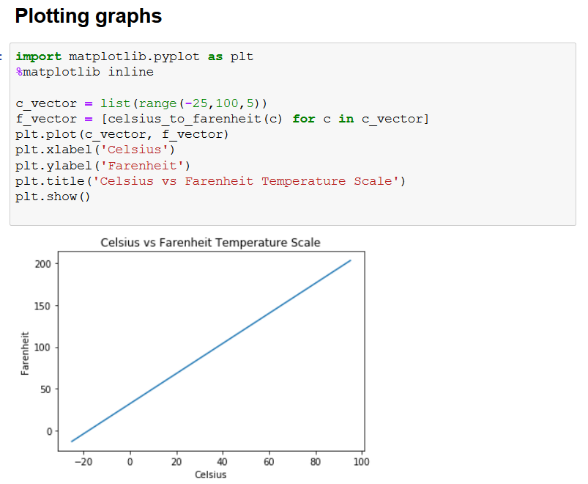

Slide 12
Accessing previous inputs/outputs
Print(_)
In[8]

